Slide 1
Introduction -Phonetics

Slide 2
Phonetics – Study of human speech sounds
Phonology – Study of how sounds are organized in a language.
Phoneme – Minimal distinctive units of sound.

Slide 3
Why learn Phonetics?
No one to one relationship between the letters of the alphabet and the sounds they represent - unique to the English language
character, machine, church
English as a second language
Received Pronunciation – R. P (South-East of England)

Slide 4
Three branches – Articulatory, Acoustic and Auditory phonetics
Articulatory – how speech sounds are produced by human vocal apparatus
Acoustic – sound waves made by humans
Auditory – how speech sounds are perceived by the auditory system

Slide 5
Speech Process
Speech is highly complicated process
a. Psychological – formulate the concept in the brain
b. Articulatory or physiological - nervous system transmitting the message

Slide 6
Speech Process (contd.)
c. Acoustic- organs of speech creating disturbances in the air
d. Auditory – ear drums receiving the message
e. Cognition – decoding or interpreting the message

Slide 7
Speech Mechanism
Respiratory System - lungs, bronchial tubes and the windpipe or trachea
Phonatory system - larynx or voice-box
Articulatory System – nose, lips and the mouth, teeth and teeth – ridge

Slide 8
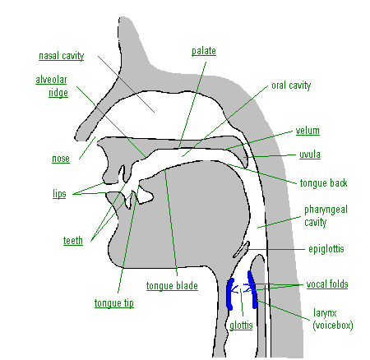

Slide 9
Air- Stream Mechanism
Egressive and ingressive
Three air stream mechanisms – Pulomic, glottalic, velaric
Pulmonic air –stream mechanism – consists of the lungs and respiratory muscles - initiator
Glottalic – larynx with the glottis firmly closed is the initiator
Velaric - back of the tongue is the initiator

Slide 10
Larynx or Glottis
Larynx consists of the vocal cords
Opening between the vocal cords is called the glottis.
Four states of glottis:
Open glottis – voiceless sounds –s, p, t, k…
Glottis in vibration – voiced sounds – d,b,g….
Closed glottis – cough, hiccups
Narrowed glottis – whisper

Slide 11
Soft Palate (Velum)
Roof of the mouth – upper teeth, alveolar or teeth-ridge, hard – palate, soft palate or velum ,uvula
Soft palate can be raised or lowered
Soft palate is lowered – air escapes through the nose and mouth – nasalised sounds – m,n,
Soft palate is raised - nasal passage is shut – air escapes – oral sounds

Slide 12


Slide 13
Articulators and Strictures
Active Articulators (Lower lip and the tongue ) and Passive Articulators (upper lip and the roof of the mouth )
Different kinds of strictures:
a. Complete closure - m, p, t, d, k ,g
b. Close approximation – f, v , z,
c. Intermittent closure - r
d. Partial closure – l
e. Open approximation – all vowels.

Slide 14
English Vowel sounds
Produced with open approximation escape of air through the mouth without any friction
Position of the tongue front , centre and back
Height of the tongue
Position of the lips

Slide 15
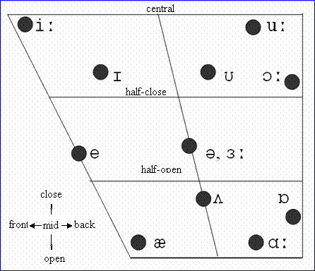
Vowels

Slide 16
